Slide 1

DC-1 C3 Facilitators

Slide 2
​
Identify a CMS and its running port​
Interact with Drupal CMS​
Determine the CMS Version​
Research Known Vulnerabilities​
Use Metasploit to Exploit a CMS​
Use MySQL to access database
Learning Objectives

Slide 3
What is Drupal CMS
Drupal is a free, open-source content management system (CMS) written in PHP.
It is used to build and manage websites ranging from simple blogs to complex enterprise-level applications.
Drupal is known for its strong security practices.
Often chosen for government and enterprise websites because of its focus on security.
Common Use Cases
Government portals (Whitehouse.gov used Drupal in the past)
University and educational sites
Non-profit and NGO websites
Media and publishing platforms
E-commerce

Slide 4
Default Paths (often used in enumeration and scanning):
/user/login – Login page
/admin – Admin panel
/node/1 – First content item (can expose internal data)
/robots.txt – May reveal hidden directories
/sites/default/ – Default site directory
/CHANGELOG.txt – May leak version info

Slide 5
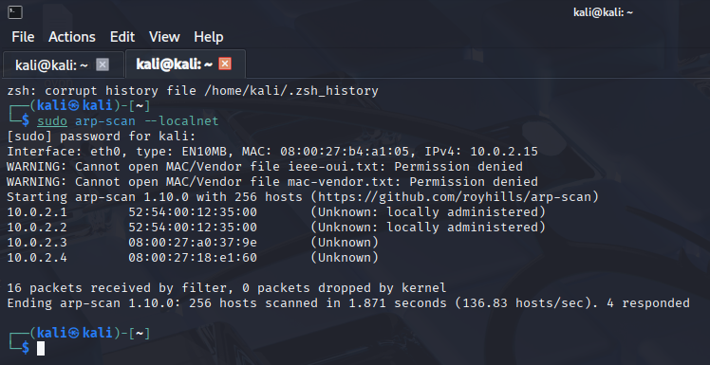
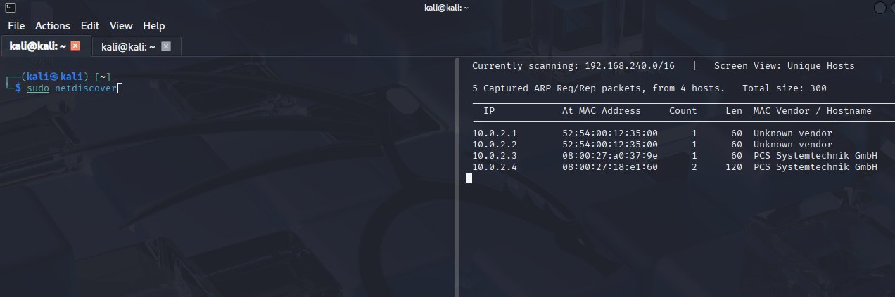
Host Discover
Reconnaissance
sudo arp-scan --localnet
sudo arp-scan --localnet is used to discover all devices on your local network using ARP (Address Resolution Protocol).
sudo netdiscover sudo netdiscover is a handy tool for passive and active scanning of live hosts on your local network using ARP requests.

Slide 6

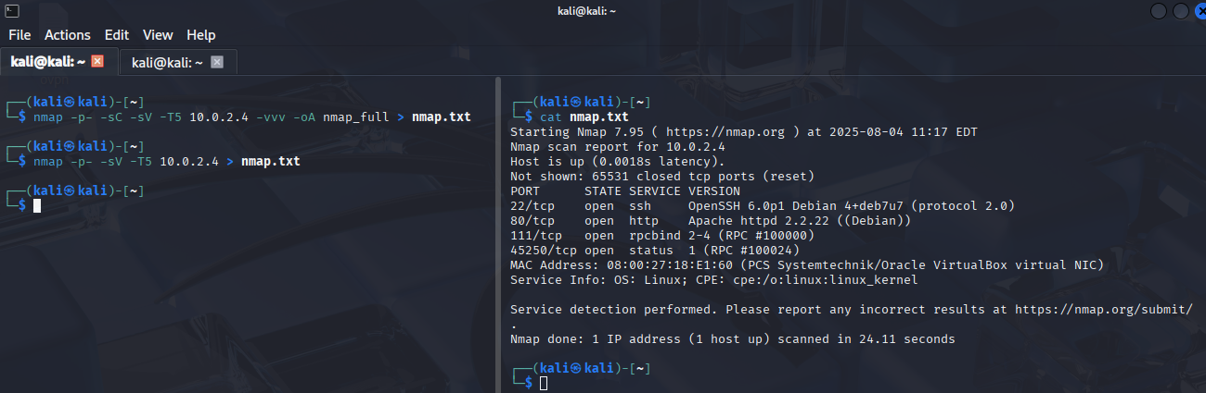
DC – 1 Target Information
Target IP: 10.0.2.4
nmap -p- -sC -sV 10.10.74.36 -vvv -oA nmap_ful
22/tcp open ssh syn-ack ttl 64 OpenSSH 6.0p1 Debian 4+deb7u7 (protocol 2.0)
80/tcp open http syn-ack ttl 64 Apache httpd 2.2.22 ((Debian))
111/tcp open rpcbind syn-ack ttl 64 2-4 (RPC #100000)
45250/tcp open status syn-ack ttl 64 1 (RPC #100024)

Slide 7
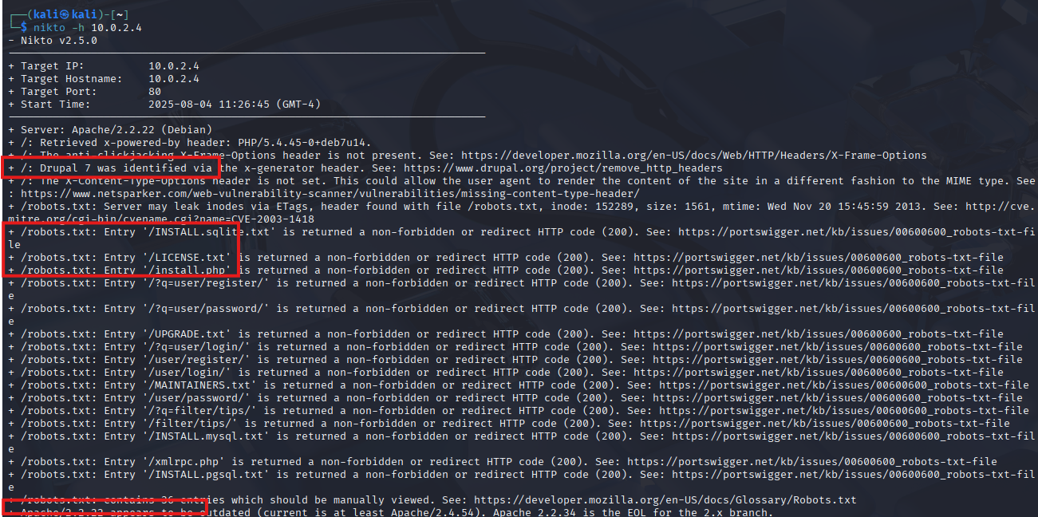
DC – 1 Target Information
nikto -h 10.0.2.4
Nikto is used to scan a web server for vulnerabilities, a popular open-source web server scanner. It performs comprehensive tests against web servers to find vulnerabilities, outdated software versions, and configuration issues.
Server: Apache/2.2.22 (Debian)
Drupal 7 was identified via the x-generator header.
/robots.txt: Entry '/INSTALL.sqlite.txt’

Slide 8
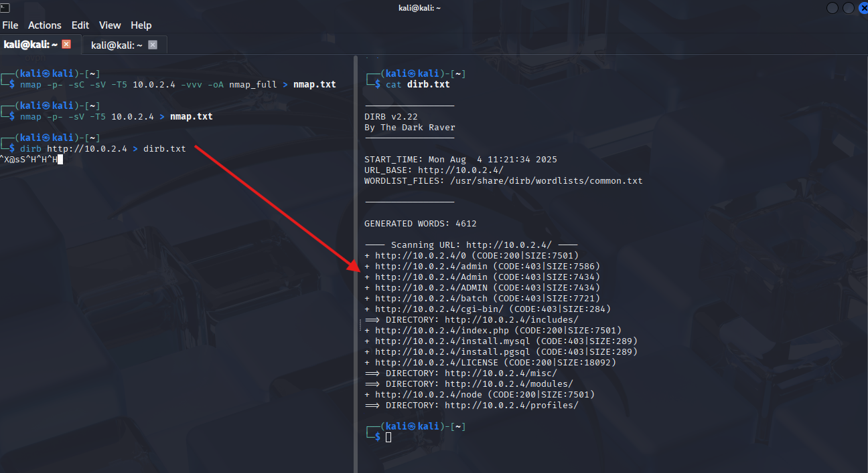
DC – 1 Target Information
dirb http://10.0.2.4
http://10.0.2.4/0 (CODE:200|SIZE:7501)
http://10.0.2.4/admin (CODE:403|SIZE:7586)
http://10.0.2.4/Admin (CODE:403|SIZE:7434)
http://10.0.2.4/ADMIN (CODE:403|SIZE:7434)

Slide 9
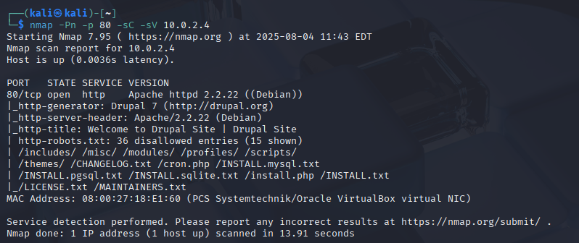
Q1: What is the version number of Drupal?
nmap -Pn -p- -sC -sV 10.0.2.4 -vvv -oA nmap_full
-sV Service version detection (e.g., Apache 2.4.41)
-Pn No host discovery (assumes the host is up
-sC Run default scripts (same as --script=default)

Slide 10
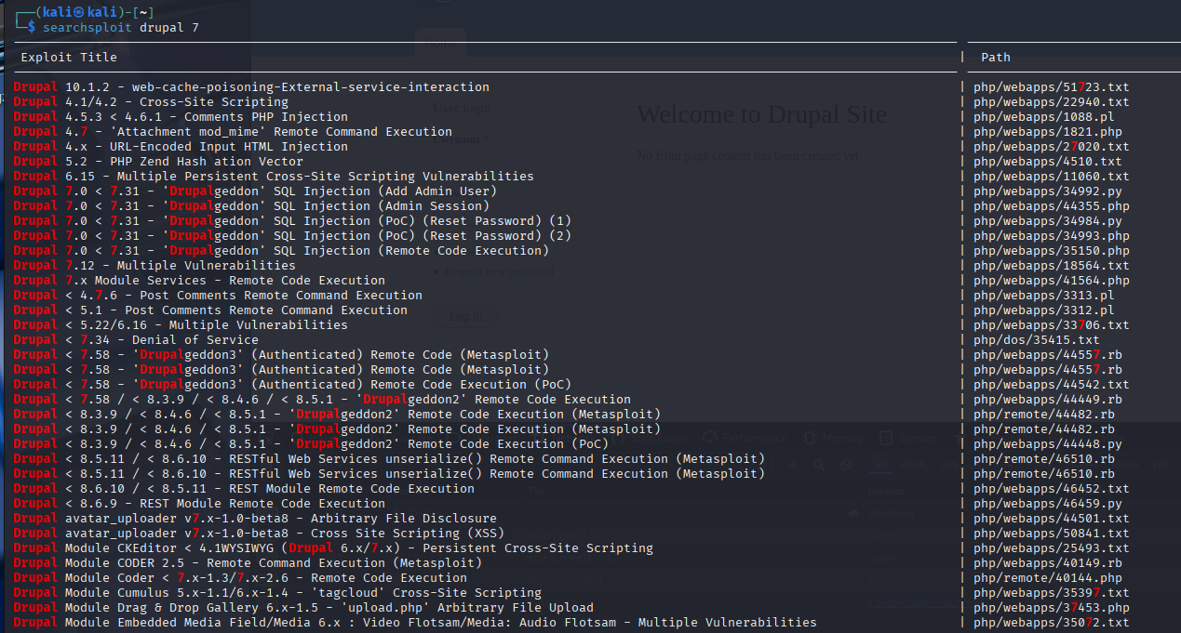
Q2: What is flag1?
Use SearchSploit command and try to find exploit for the target
SearchSploit is a command‑line tool that allows you to search Exploit‑DB (Exploit Database) directly from your terminal—without having to visit the website. It gives you quick access to thousands of public exploits, proof‑of‑concepts, and shellcode for penetration testing and vulnerability research.
Notes:
Exploit Target
Id: 0
Name: Drupal 7.0 - 7.31 (form-cache PHP injection method)
This tells you the exploit will only work on Drupal versions 7.0 to 7.31 using a specific vulnerability (PHP injection via form cache). Make sure your target is within that range.

Slide 11
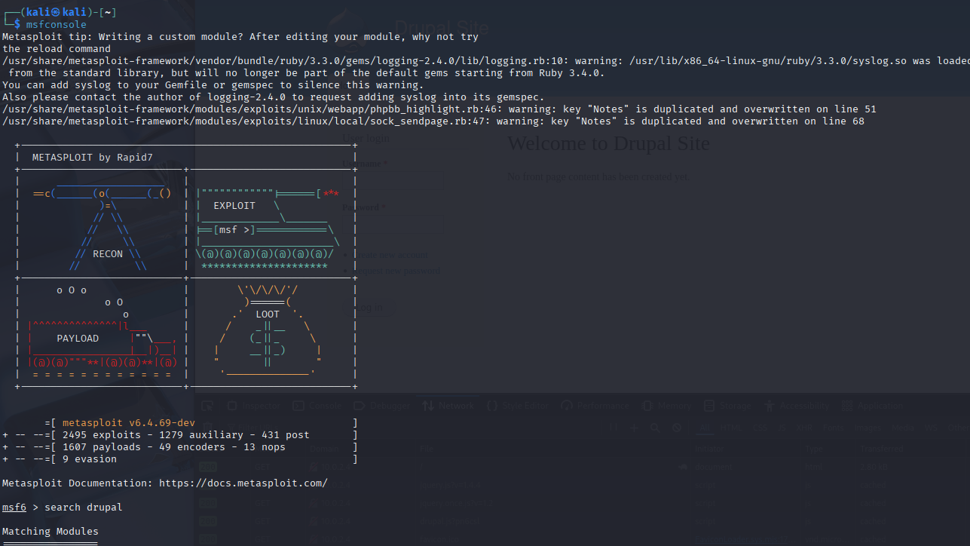
Q2: What is flag1?
Metasploit - msfconsole
Metasploit is a powerful tool. Running msfconsole starts the Metasploit Framework Console, the interactive command-line interface to work with Metasploit modules like exploits, payloads, scanners, and more.. It’s used by security professionals, ethical hackers, and CTF players to discover, exploit, and validate vulnerabilities in systems.

Slide 12
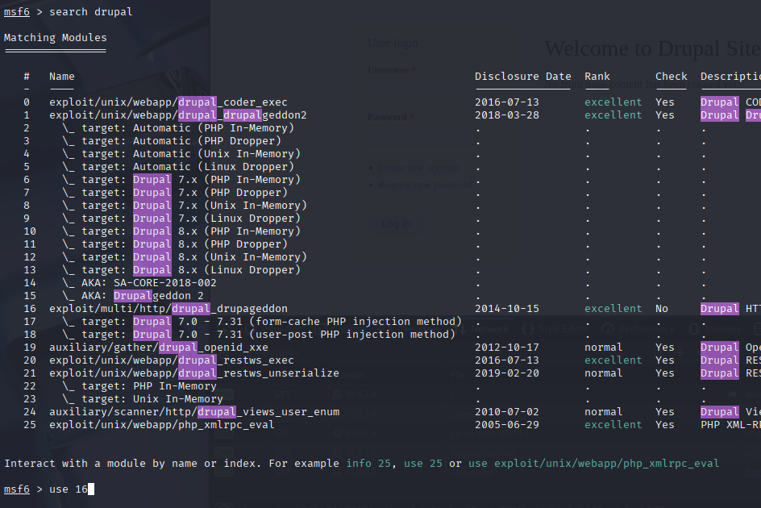
Q2: What is flag1?
Select exploit target
Chose the following Exploit then added the parameters needed to attack the box: use 16 or use 1
Notes:
Exploit Target
Id: 0
Name: Drupal 7.0 - 7.31 (form-cache PHP injection method)
This tells you the exploit will only work on Drupal versions 7.0 to 7.31 using a specific vulnerability (PHP injection via form cache). Make sure your target is within that range.

Slide 13
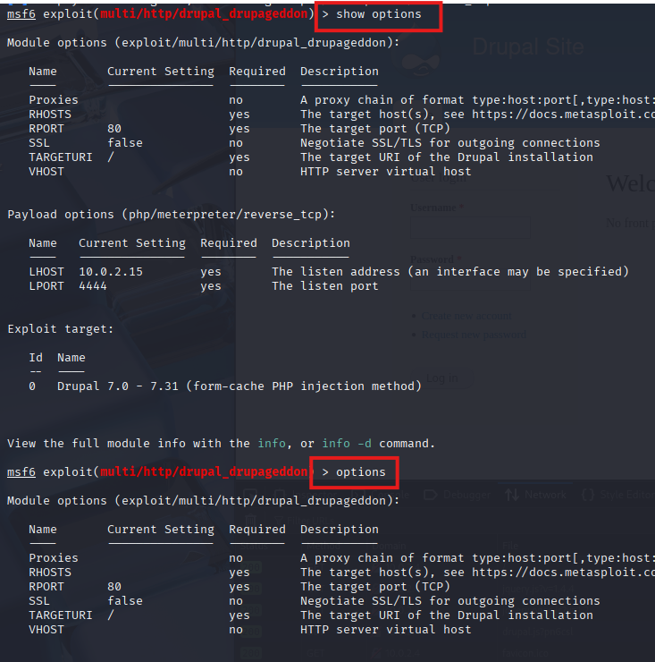
Q2: What is flag1?
Show options - options
Displays required and optional parameters for the current exploit or auxiliary module and its payload.
Always use it after selecting a module (like use exploit/multi/http/drupal_drupalgeddon) to see what needs to be configured before running it.

Slide 14
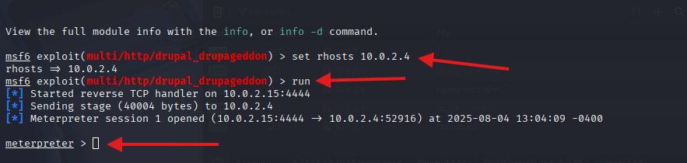
Q2: What is flag1?
Set RHOSTS to Target IP
RHOST: Target IP or domain
RPORT: Target Port
TARGETURI: The path to Drupal (e.g., /drupal/)
LHOST: Your local IP to receive the reverse shell
Set this to your Kali/attacker IP (e.g., tun0 for VPN)
LPORT: The port on your machine to receive the shell
Exploit / Run: Executes the selected exploit module with the current settings
Exploit and Run — both commands do the same thing.
Attack the Drupal site at 192.168.1.100/drupal
Trigger the vulnerability
If successful, give you a reverse shell session (via Meterpreter)

Slide 15
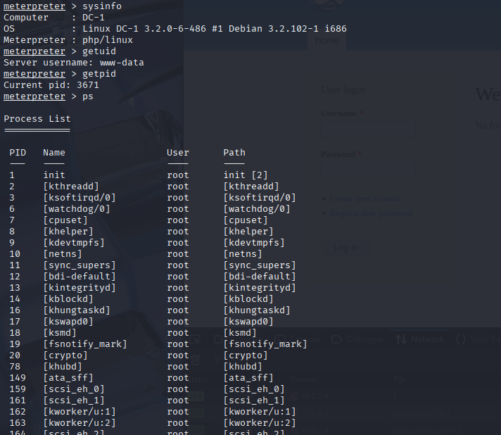
Q2: What is flag1?
sysinfo – getuid – getpid – ps - shell
Sysinfo
Displays system information about the target.
Understand the target system (Windows/Linux, version)
Choose correct privilege escalation techniques
Confirm if you're on the intended host
Getuid
Meterpreter shows the user context that your Meterpreter session is running
The username or privilege level of the exploited process
Ps
Unix/Linux stands for process status.
It’s used to display information about active processes running on your system.
Shows processes running in the current shell session.
Shell
To interact directly with the compromised system without Meterpreter's abstraction.

Slide 16
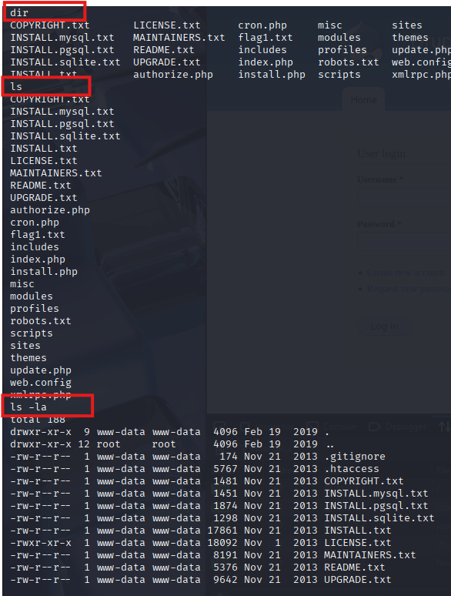
Q2: What is flag1?
dir / ls / ls -la
dir
Usually used in Windows Command Prompt and also available in some Unix/Linux shells.
Lists files and directories in the current directory.
Shows names of files and folders, often with some basic details on Windows.
ls
Unix/Linux/macOS terminals.
Lists files and directories in the current directory.
lists file and directory names without hidden files or detailed info.
ls -la
Unix/Linux/macOS terminals.
Lists all files, including hidden files, with detailed info.
-l: Long format — shows permissions, number of links, owner, group, file size, and modification date.
-a: All files — includes hidden files.

Slide 17
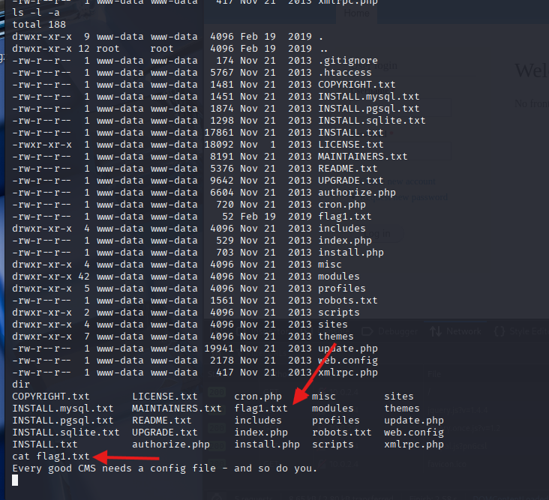
Q2: What is flag1?
cat flag1.txt

Slide 18
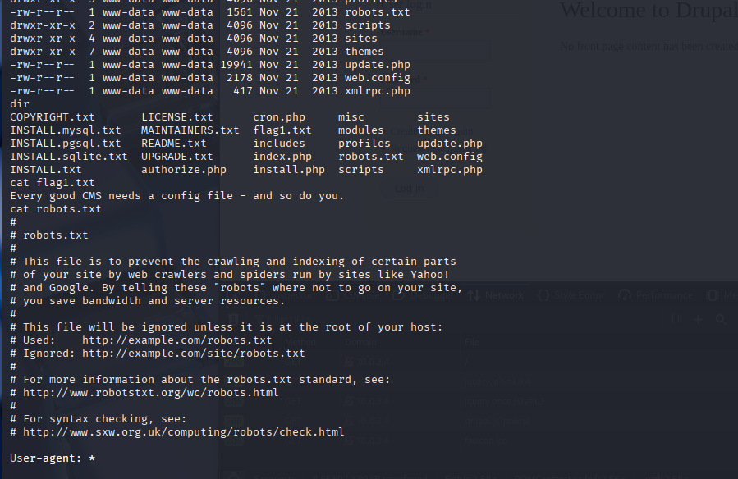
Continue enumeration the target

Slide 19
Q3: What is flag2?
For flag 1 read the txt file and get some clue.
Every good CMS needs a config file – and so do you
In Drupal man configuration file is settings.php which located sites/default directory.
This file contains site-specific configurations, most importantly the database connection settings.
settings.php
Database connection info (host, database name, username, password, driver)
Trusted host patterns
File system paths
Other site-specific settings and overrides

Slide 20
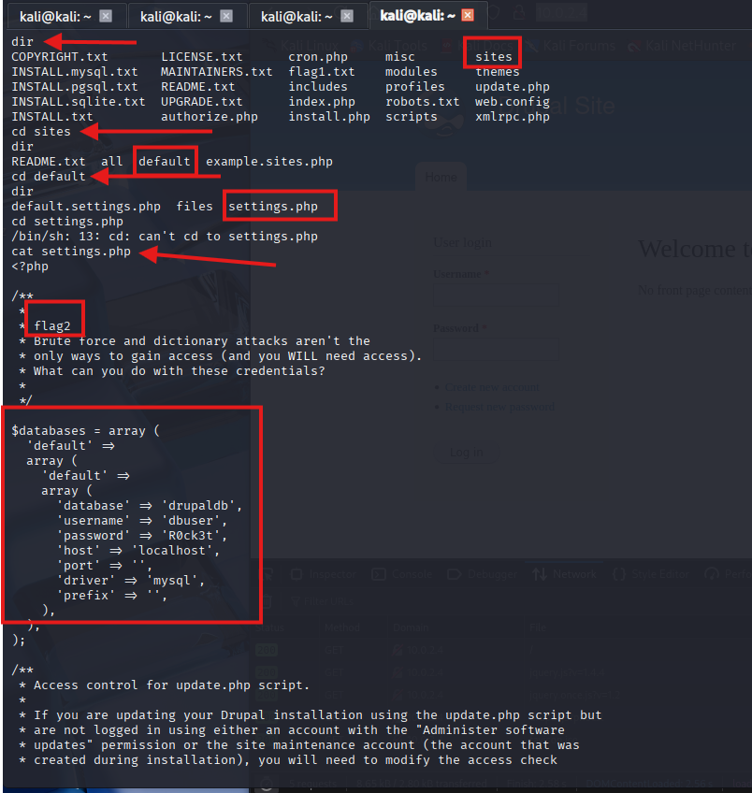
Q3: What is flag2?
Navigate to sites directory

Slide 21
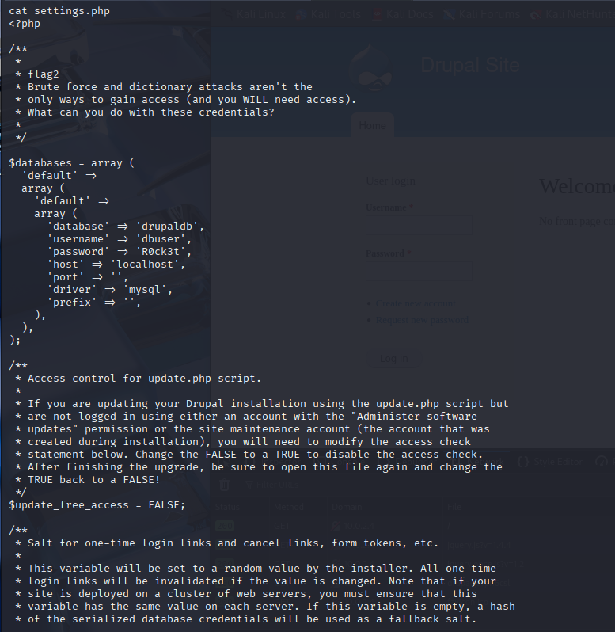
Q4: What is the username and password of the MySQL?
Read the settings.php file

Slide 22
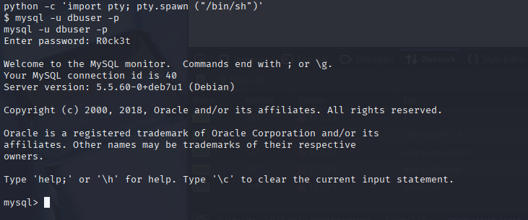
Q5: What is flag3 ?
After find, some information for the MySQL login credentials lets explore with this.
Interactive with shell
python -c 'import pty; pty.spawn("/bin/sh")’
This command uses Python to spawn a pseudo-terminal shell (/bin/sh) — a trick often used during reverse shells or privilege escalation in penetration testing.
mysql –u dbuser -p
Notes:
python -c 'import pty; pty.spawn("/bin/sh")’

Slide 23
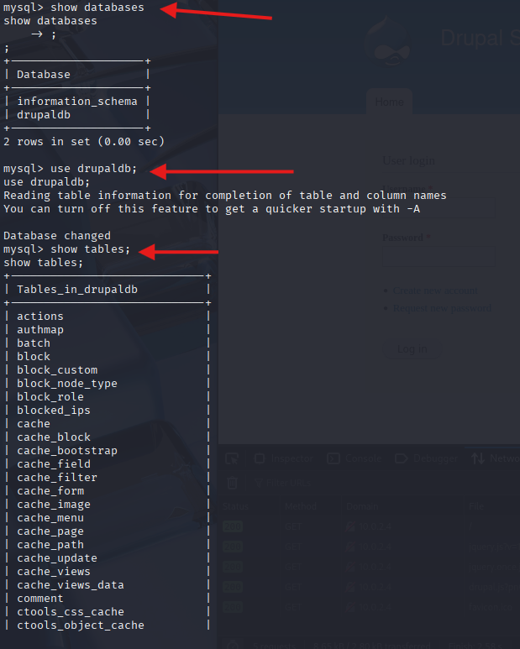
Q5: What is flag3 ?
MySQL (or MariaDB) commands commonly used to interact with database.
Show databases;
Lists all the databases available on the MySQL serve
Use drupaldb;
Selects the database you want to work with — in this case, drupaldb.
Show tables;
Lists all the tables inside the currently selected database (drupaldb).
Notes:
Selects the database you want to work with — in this case, drupaldb.
Think of it like saying: “Switch to this database so I can run queries inside it.”
SHOW DATABASES; List all databases
USE drupaldb; Select the drupaldb to work with
SHOW TABLES; List tables inside drupaldb

Slide 24
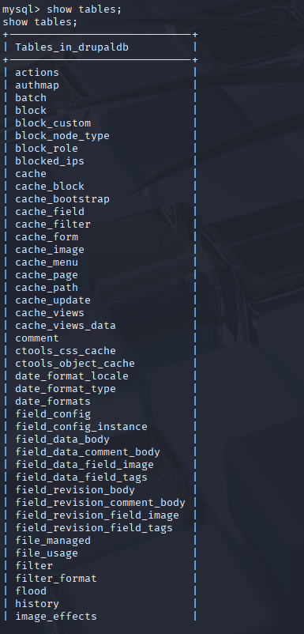
Q5: What is flag3 ?
Show tables;
After type Show tables; we are able to see many tables in drupaldb and as penetration tester we need to check all or some important tables in there.
Users → Stores usernames, hashed passwords, email addresses, and statuses. Primary target for credential extraction.
Sessions → May contain session IDs — useful for session hijacking if session cookies are not properly secured.
users_roles → Shows which users have which roles. Helps identify admin users.
Node → Contains the site's content. May leak internal information or be used for XSS testing.
url_alias → Helps map custom URLs to internal paths — can help find hidden admin pages
file_managed → Tracks uploaded files. Look here for file upload vulnerabilities.
field_data_body → Drupal stores the full content

Slide 25
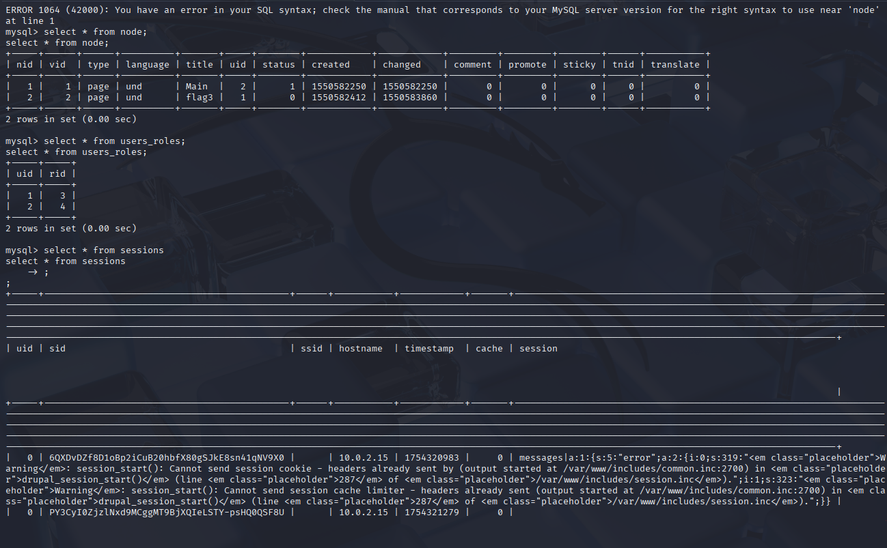
Q5: What is flag3 ?

Slide 26
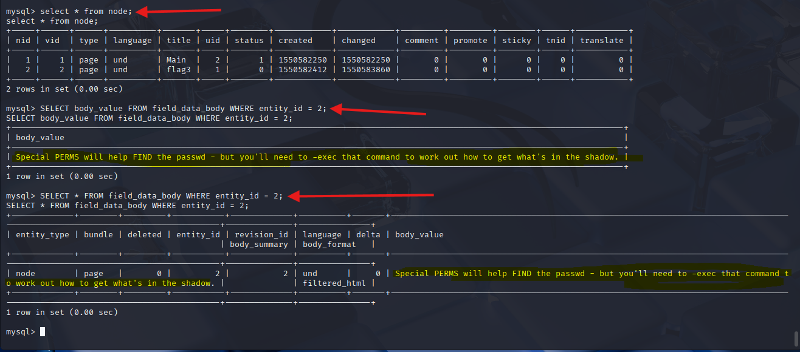
Q5: What is flag 3 ?
Read flag in mysql
select * from field_data_body where entity_id = 2;
or
select body_value from field_data_body where entity_id = 2;
entity_id: links to the nid from the node table.
body_value: is the actual content field where the flag is likely stored.
Notes:
select * from field_data_body where entity_id = 2; → This query returns all columns (*) for the row(s) where entity_id = 2.
select body_value from field_data_body where entity_id = 2; → This query returns only the body_value column for the row(s) where entity_id = 2.
Use SELECT * when you want to inspect the entire row (for debugging, exploring, etc.).
Use SELECT body_value when you only need specific data, making your query faster and cleaner.

Slide 27
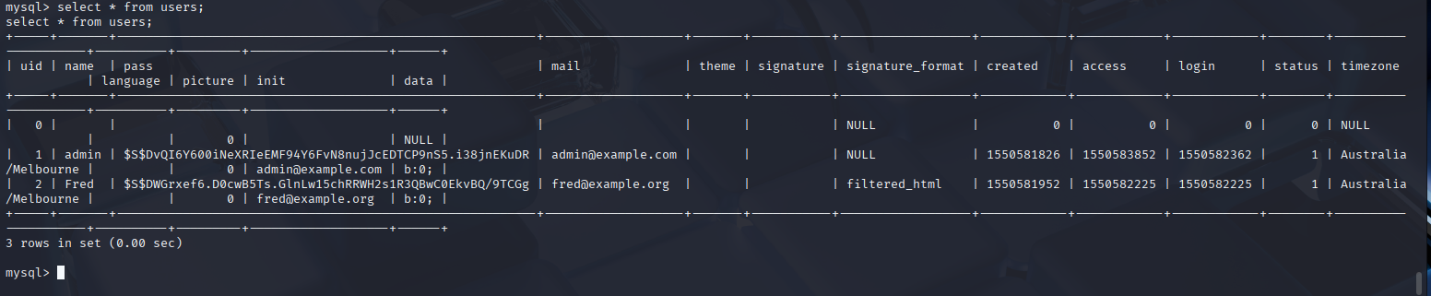
Continue explore the machine’s databases
Try to find some other user and possible passwords.
We have found two user, email and password and continue with crack the password hashes
Admin → admin@example.com
Fred → fred@example.com

Slide 28
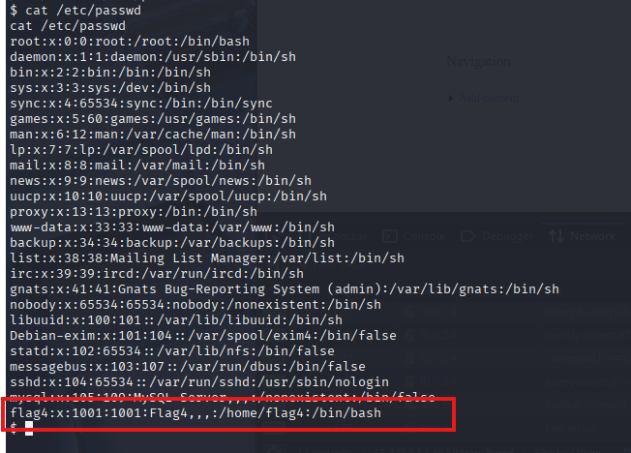
Q6: What is flag 4 ?
Flag3 HINT | Special PERMS will help FIND the passwd - but you'll need to -exec that command to work out how to get what's in the shadow.
Cat /etc/passwd
The /etc/passwd file in Linux is contains essential information about user accounts.
Holds user details such as usernames, user IDs (UIDs), group IDs (GIDs), home directories etc.

Slide 29
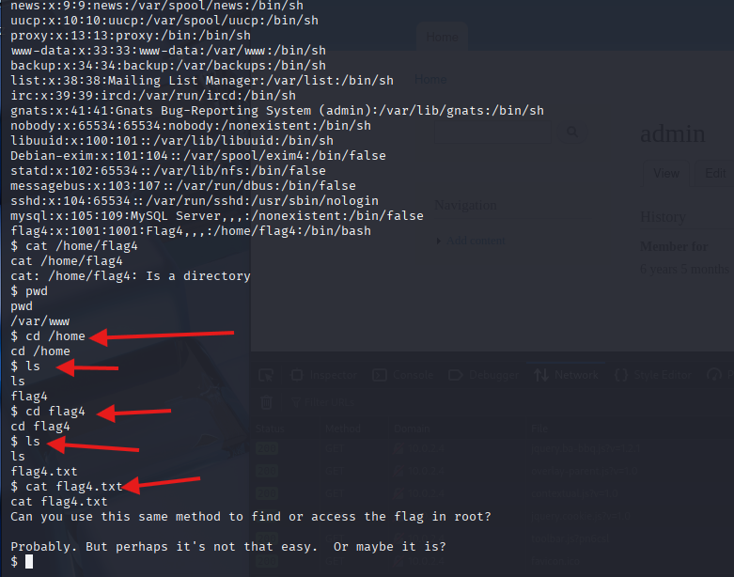
Q6: What is flag 4 ?
Read the file and it mentioned that flag4 is in /home/flag4 directory
Basically, change your directory and find the flag4.txt file
Notes:
In image we noticed that flag4 is directory/user and if we check shadow file to try to find hashes and we can crack the hash and with that password we can able to login with ssh
Cat /etc/shadow

Slide 30
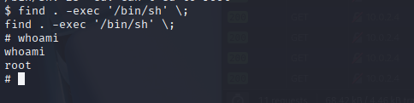
Q7: What is the final flag.txt?
find . -exec '/bin/sh’ \;
Search all files and directories starting from the current directory (.)
Each item it finds, run /bin/sh
This technique used in privilege escalation when a binary runs find insecurely with -exec
Notes:
find . → Searches recursively starting from the current directory (.)
-exec: Tells find to execute a command on each file found.
/bin/sh: This is the shell that will be executed.
\;: Marks the end of the -exec command

Slide 31
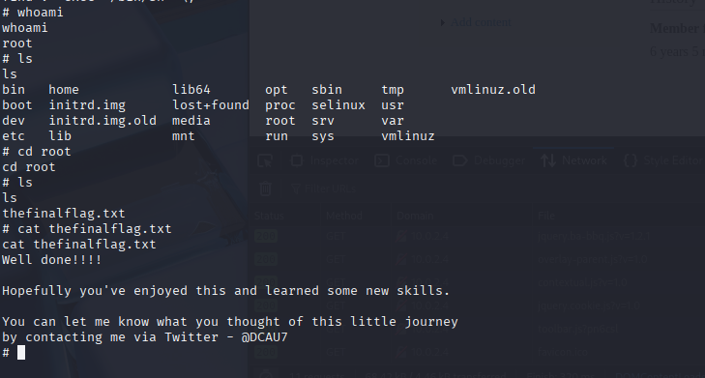
Q7: What is the final flag.txt?

